Slide 1
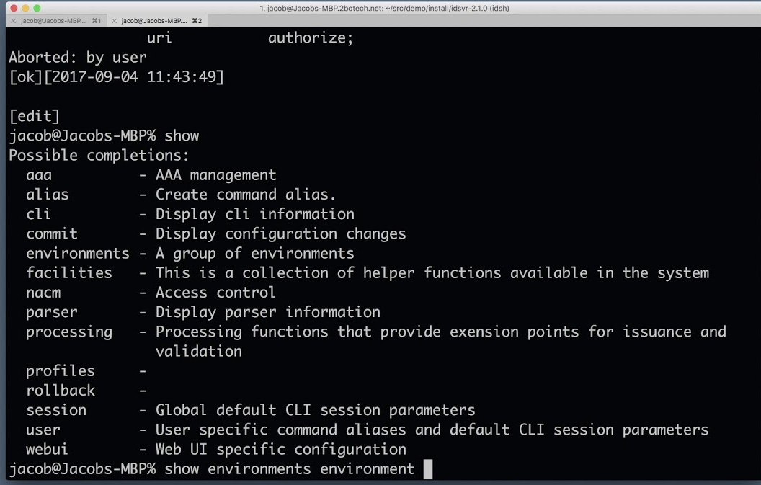
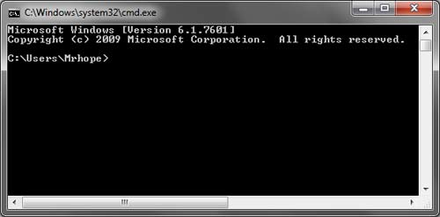
Lesson 2.1. Command-line Interface
Most computer users interact with a computer via graphical user interface (GUI) Examples: MacOS, Windows You can interact with a computer by sending commands in command-line interface (CLI) Command-line interface (CLI) is a text-based interface that is used to operate software and operating systems by typing single commands into the interface and receiving a reply in the same way
MacOS
Windows

Slide 2
Lesson 2.1. Command-line Interface
Why we will use CLI: - Each Developer should know how to use CLI - It is much quicker to navigate and interact with a computer - It will give you broad knowledge of how computer works How we will use CLI: - Working with files and directories - Opening and closing a programs - Managing computer processes
- Writing code - GIT

Slide 3
Lesson 2.1. Command-line Interface
Basic commands: pwd - print working directory
cd - (change directory) change directory to root folder
cd .. - go to previous directory
ls - list content
man - manual
mkdir - make directory (create a folder)
touch - create a file
rm - remove (delete) a file
rmdir - remove (delete) a directory
clear - clear terminal
Let’s try!

Slide 4
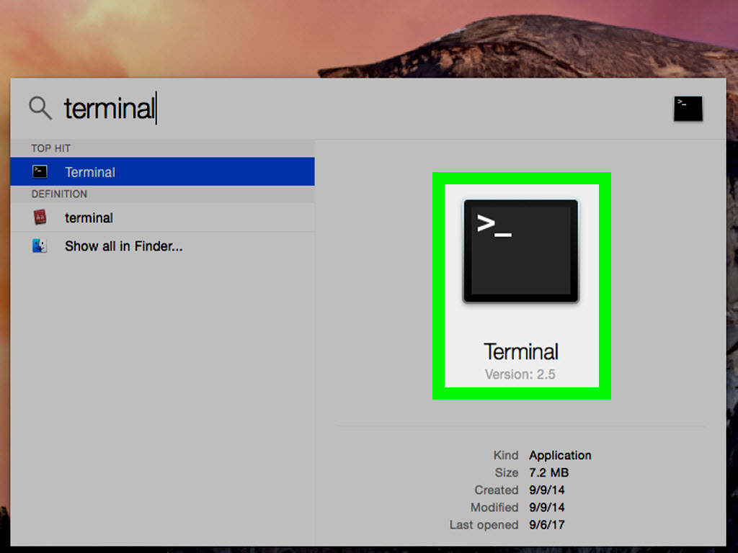
Lesson 2.1. Command-line Interface
How to open CLI in MacOS: - You can go to Launchpad -> Utilities -> Terminal - Find Terminal via Spotlight If you are on Windows please see next video so you can see how to setup UNIX environment on your computer and continue the course

Slide 5
Lesson 2.1. Command-line Interface
Homework: Create a directory structure listed below using CLI:
Course (directory)
Module 2. Setting up Environment (directory)
Lesson 1. Command-line Interface (directory)
My new file.txt (file .txt)

Slide 6
Lesson 2.1. Command-line Interface
Recap: 1. CLI vs GUI 2. Why and how we will use CLI 3. Basic CLI commands 4. Created simple directory structure

